Slide 1

GDP per Capita and Life Expectancy Project
By Caleb Myhra
Notes:
Hi my name is Caleb Myhra and my project is on GDP and Life Expectancy

Slide 2
Business Need
Life expectancy varies greatly around the world
Average Life expectancy is 73
Lesotho only just over 50
Japan over 84
Wealth is a major factor
GDP per capita measure of wealth per citizen
Notes:
Wealth is a major factor, as it increases access of everything, food, water, and medicine

Slide 3
Project Goals
Analyze relationship between GDP and life expectancy
Create a regression model
Analyze variations between regions
Analyze variations between genders
Analyze growth

Slide 4
Architecture Diagram
Kaggle
Azure Databricks (Transformation and analysis)
PowerBI Analysis Visualizations
Ingest
WHO GHO API
Transformed Data
Raw Data

Slide 5
Technologies Used
Azure
Storage
Data Bricks
VS Code
Power BI
Github

Slide 6
Ingestion
Python scripts to access data sources from WHO and Kaggle APIs
Performed exploratory data analysis
Raw CSVs saved to Azure

Slide 7
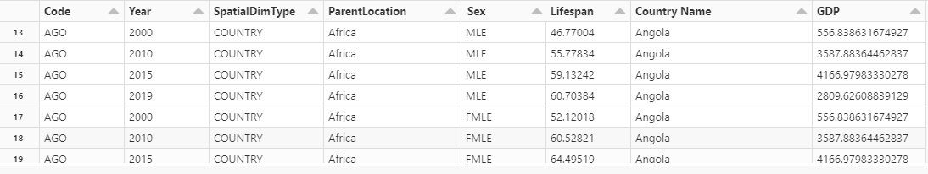
Transformation
Azure Databricks
Dropping unnecessary columns
Melting GDP years
Joining on years and country codes

Slide 8
Serving
Azure Databricks
Correlation checking
Logistic Growth Model Regression
Power BI
Visualizations

Slide 9
Averages
Year 2000
Male Lifespan 64.3
Female Lifespan 69.3
Both:66.7
GDP per capita $6401
Year 2019
Male Lifespan 70.1
Female Lifespan 75
Both:72.5
GDP per capita $14118

Slide 10
Correlation
World:
r : 0.5870
P-value: 1.26e-67
South-East Asia
r: 0.818
P-value: 1.15e-10
Western Pacific
r: 0.8024
P-value: 4.46e-20
Europe
r: 0.7334
P-value: 4.93e-35
Eastern Mediterranean
r: 0.4735
P-value: 9.12e-06
Africa
r: 0.3867
P-value: 6.37e-08
Americas
r: 0.3598
P-value: 2.62e-05

Slide 11
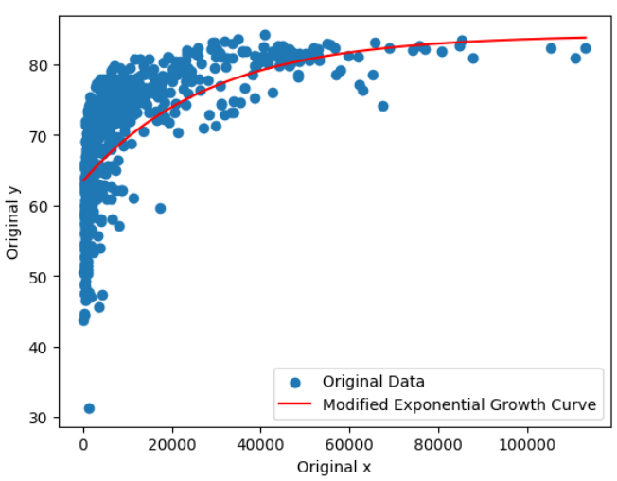
World
Male r value: 0.6049
Female r value: 0.5614
Combined r value: 0.5870
Moderate positive correlation
Stronger correlation to males then females

Slide 12
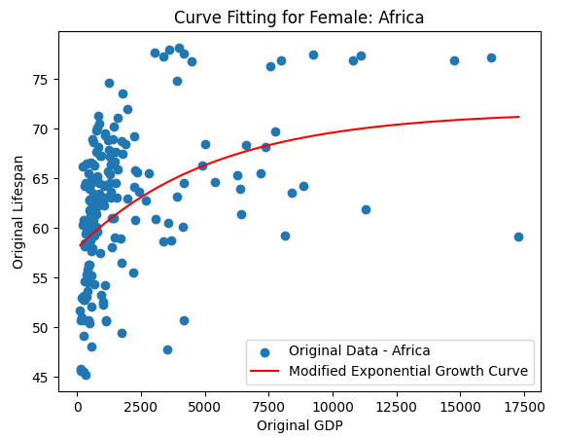
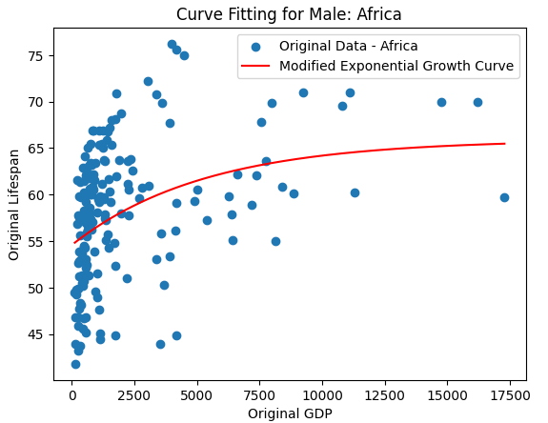
Differences in Gender

Slide 13


Slide 14


Slide 15
Key Challenges and Learnings
Azure
Power BI
Modeling and viewing GDP and age
Performing regression on a curve

